Slide 1
Simulation of thin film growth
Shawn Wimer
4/26/2024

Slide 2
Contents
Brief overview of thin film growth
Growth equations
Molecular dynamics
Ballistic deposition
Monte Carlo method

Slide 3
Thin film growth

Slide 4
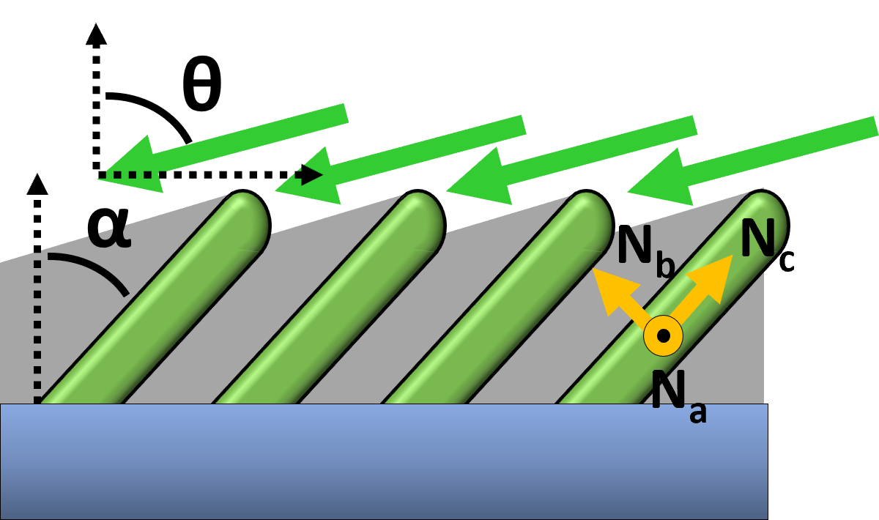
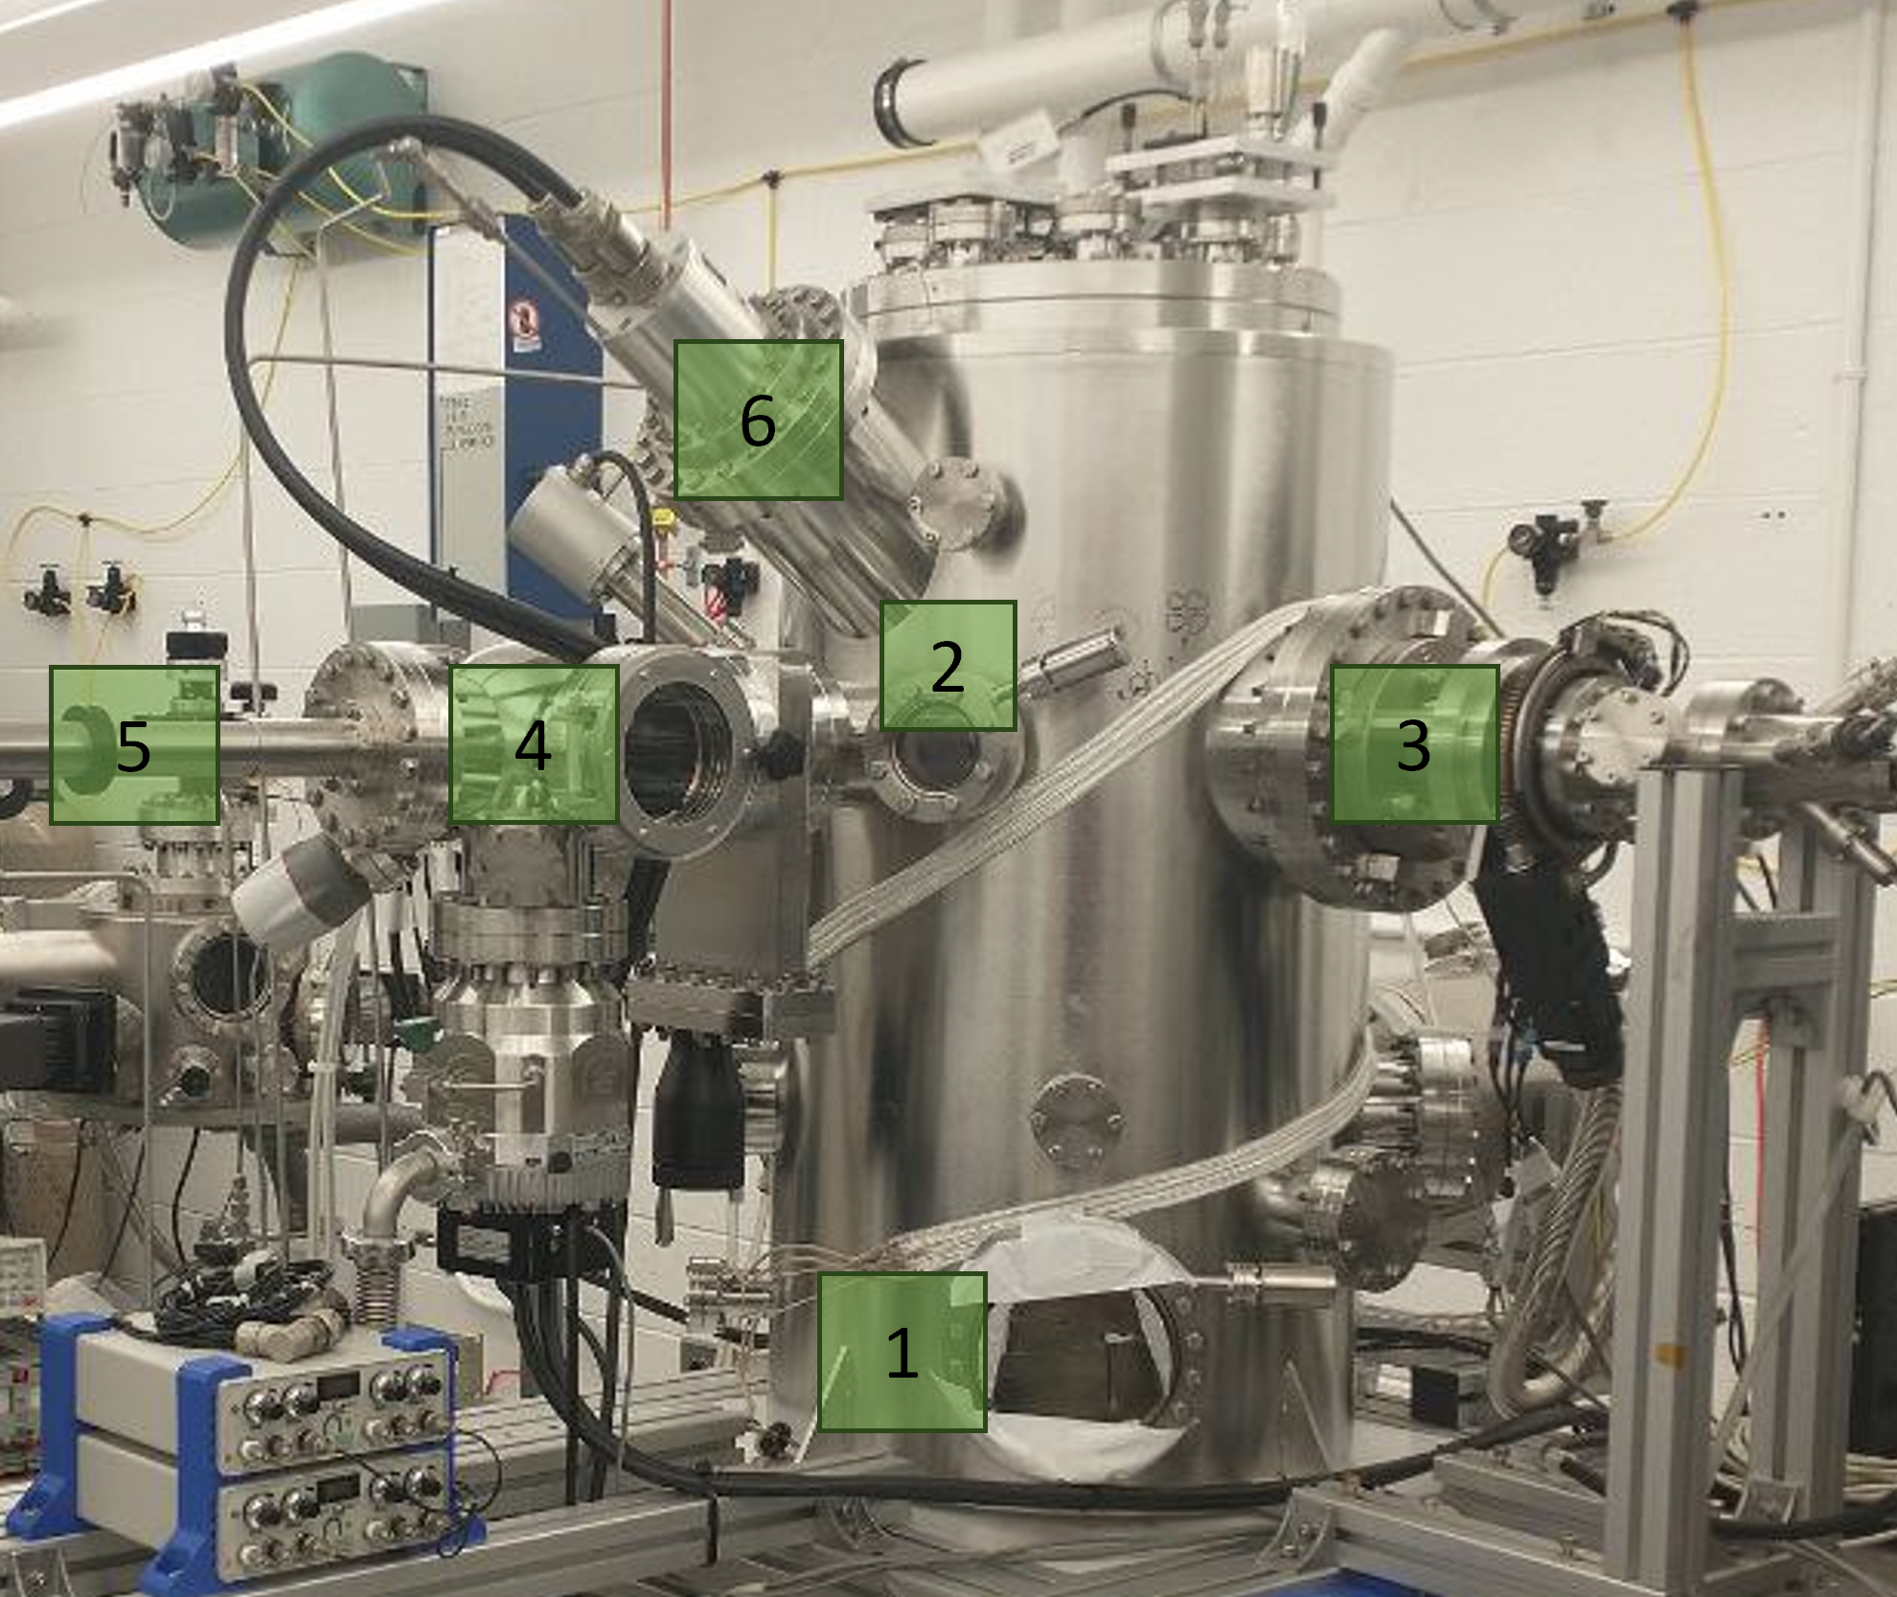
Thin film deposition
Material flux directed at substrate
Physical vapor deposition, sputtering, chemical vapor deposition, etc.
Particles can have any trajectory but the distribution depends on method and system setup
Particles can adhere become part of a film that grows on the surface or be reemitted
Thin film growth

Slide 5
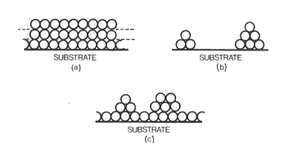
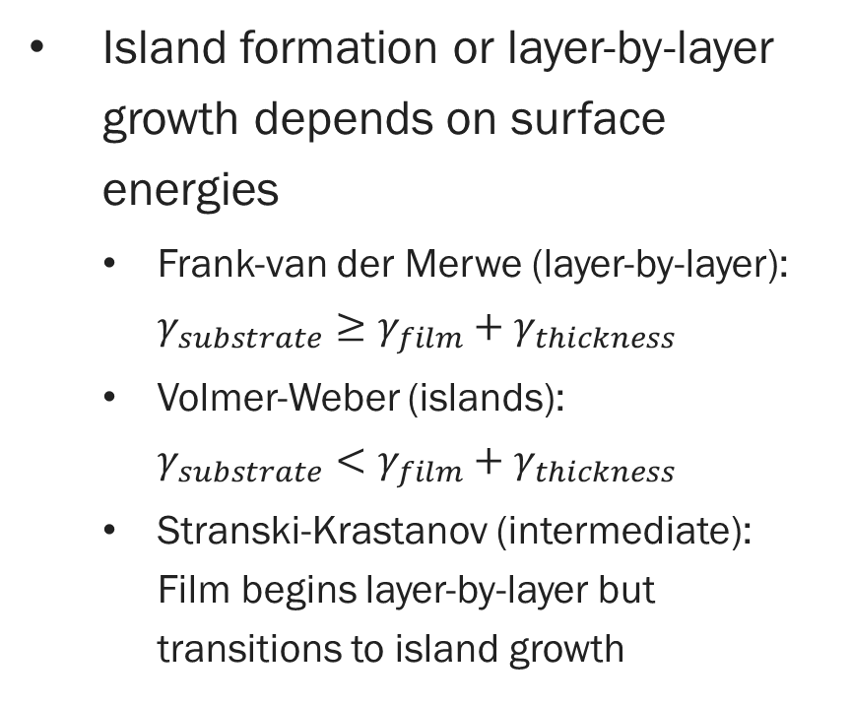
Early stage of film growth
Island formation or layer-by-layer growth depends on surface energies
Frank-van der Merwe (layer-by-layer): $γ_{substrate}≥γ_{film}+γ_{thickness}$
Volmer-Weber (islands): $γ_{substrate}<γ_{film}+γ_{thickness}$
Stranski-Krastanov (intermediate): Film begins layer-by-layer but transitions to island growth
a) FM, b) VW, c) SK
Andersson 1982 [1]
Thin film growth

Slide 6
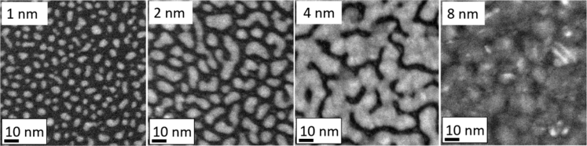
Coalescence in island growth
Islands are isolated until they grow into each other and begin coalescence
Eventually a network of connected islands and isolated voids forms
“Percolated”
Further deposition fills the voids
The time to coalescence is increased by more diffusion and decreased by higher deposition rate
Copper on a-carbon deposition over time
Colin 2020 [2]
Thin film growth

Slide 7
Growth equations

Slide 8


Thin film growth models
Very general descriptions of the interface with the volume above the surface
Simple model: the surface grows at a constant rate perpendicular to the surface at all points
Surface roughness increases until islands coalescence, then decreases
Growth equations

Slide 9

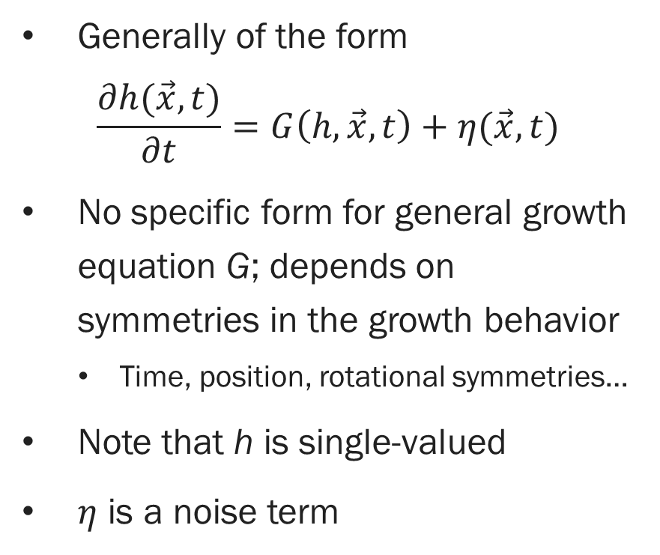
Growth equations
Single-valued
Generally of the form $\frac{∂h(\vec{x},t)}{∂t}=G\left(h, \vec{x}, t\right)+η(\vec{x}, t)$
No specific form for general growth equation G; depends on symmetries in the growth behavior
Time, position, rotational symmetries…
Note that h is single-valued
$η$ is a noise term
Not single-valued
Growth equations

Slide 10
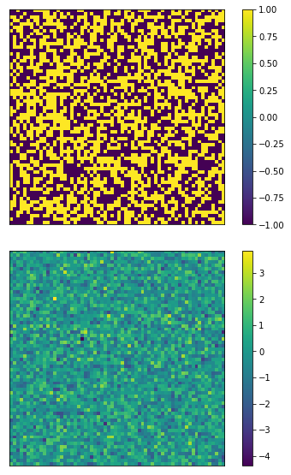
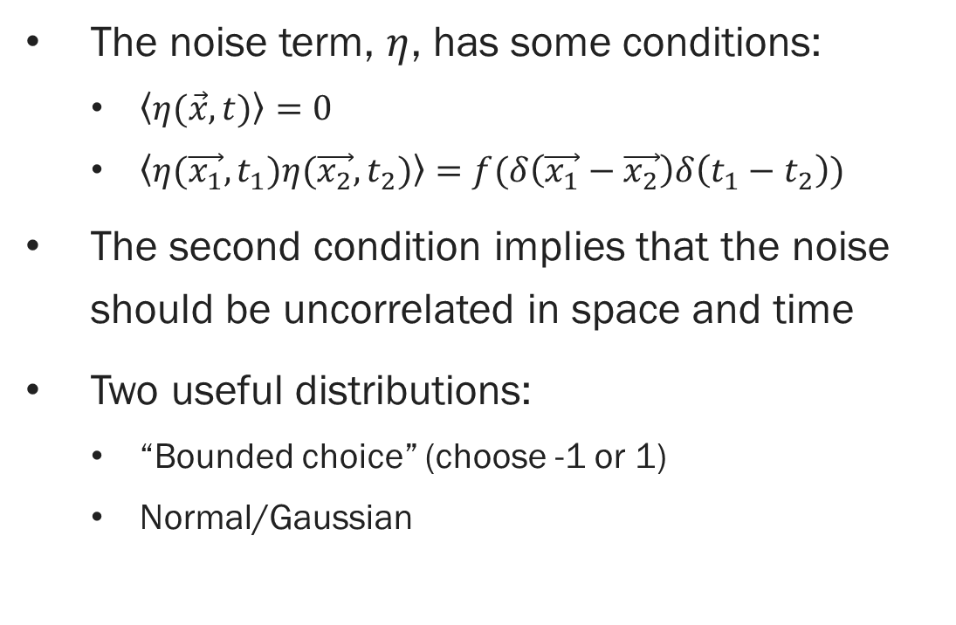

Noise term: $η(\vec{x}, t)$
The noise term, $η$, has some conditions:
$\left\langle η(\vec{x}, t)\right\rangle =0$
$\left\langle η(\vec{x_{1}}, t_{1})η(\vec{x_{2}}, t_{2})\right\rangle =f(δ\left(\vec{x_{1}}−\vec{x_{2}}\right)δ\left(t_{1}−t_{2}\right))$
The second condition implies that the noise should be uncorrelated in space and time
Two useful distributions:
“Bounded choice” (choose -1 or 1)
Normal/Gaussian
Growth equations

Slide 11
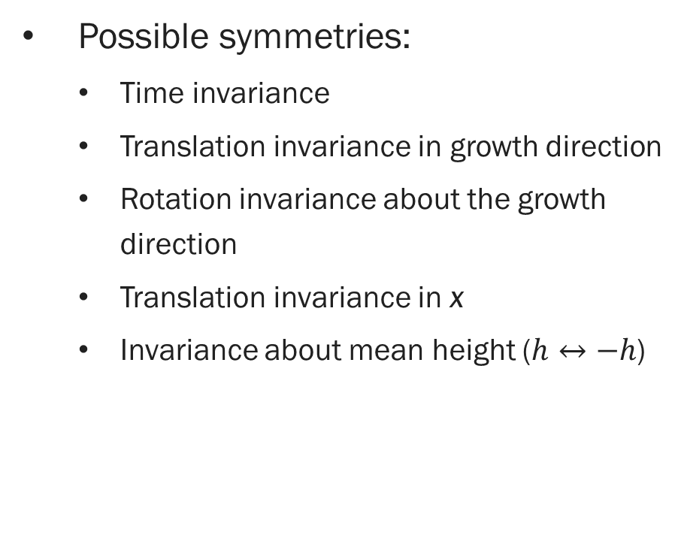
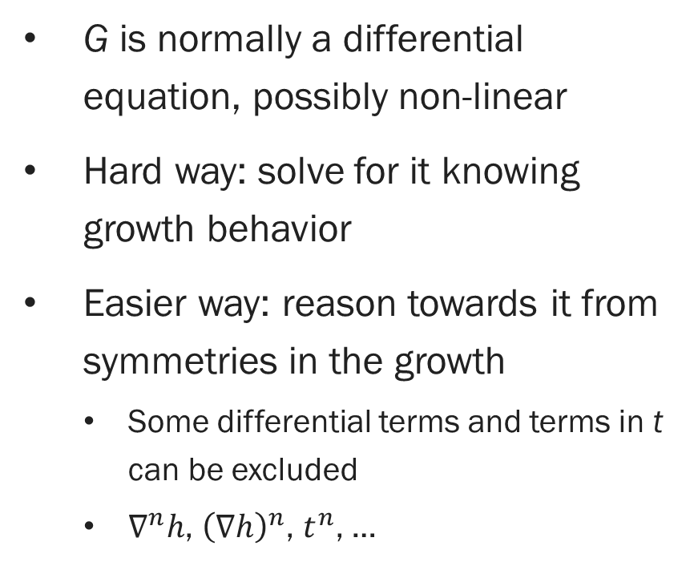
Determine G
G is normally a differential equation, possibly non-linear
Hard way: solve for it knowing growth behavior
Easier way: reason towards it from symmetries in the growth
Some differential terms and terms in t can be excluded
$∇^{n}h$, ${\left(∇h\right)}^{n}$, $t^{n}$, …
Possible symmetries:
Time invariance
Translation invariance in growth direction
Rotation invariance about the growth direction
Translation invariance in x
Invariance about mean height ($h↔−h$)
Growth equations

Slide 12
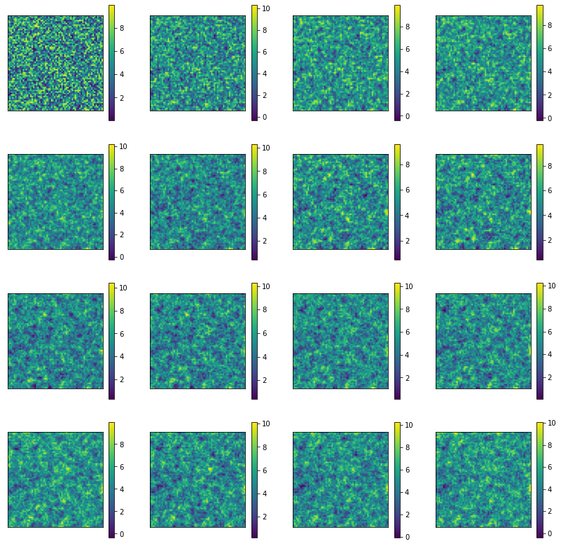
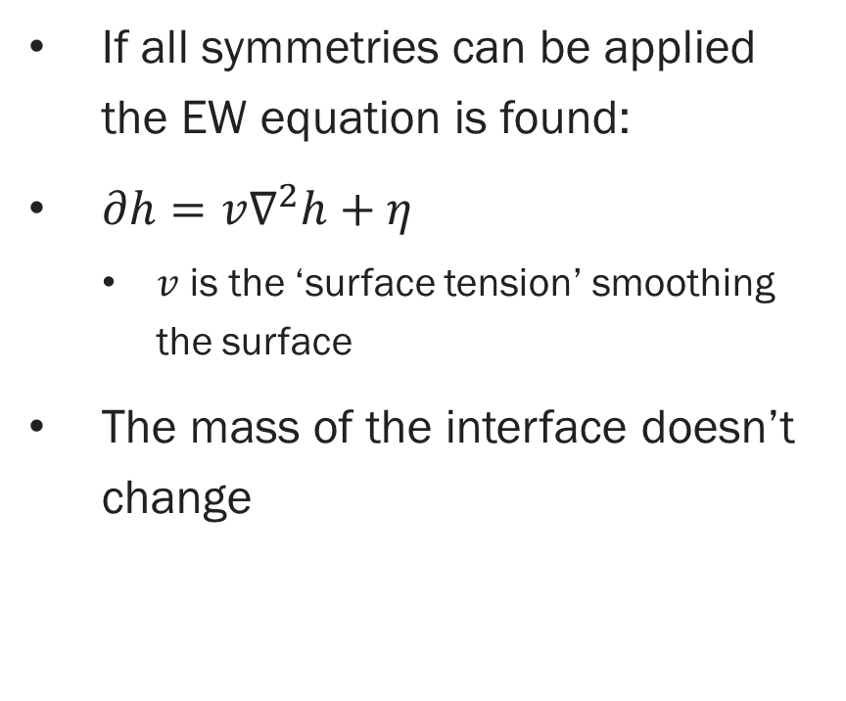
Edwards-Wilkinson equation
If all symmetries can be applied the EW equation is found:
$∂h=v∇^{2}h+η$
$v$ is the ‘surface tension’ smoothing the surface
The mass of the interface doesn’t change
Growth equations

Slide 13
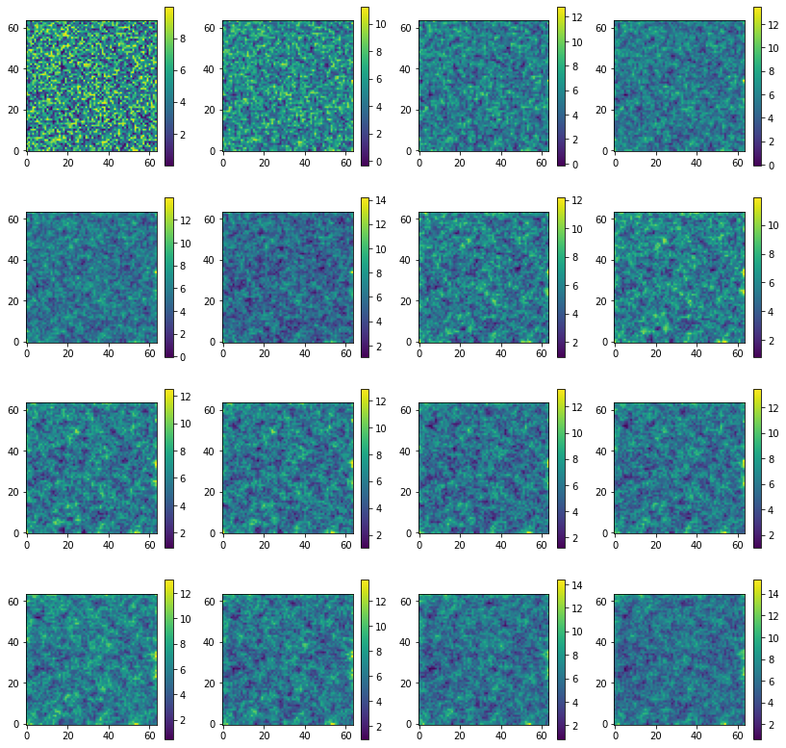
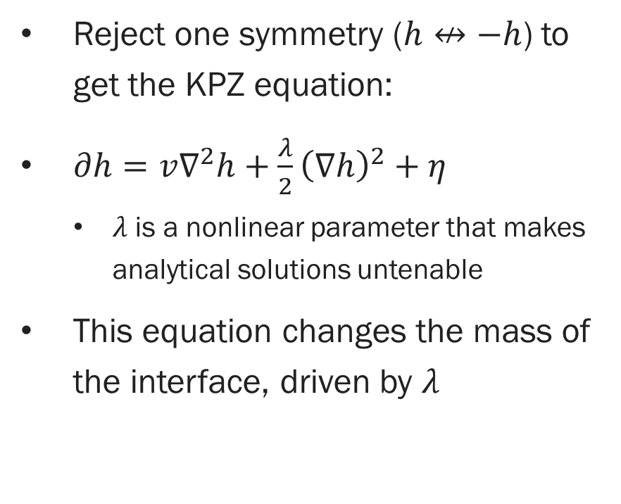
Kardar-Parisi-Zhang equation
Reject one symmetry ($h↮−h$) to get the KPZ equation:
$∂h=v∇^{2}h+\frac{λ}{2}{\left(∇h\right)}^{2}+η$
$λ$ is a nonlinear parameter that makes analytical solutions untenable
This equation changes the mass of the interface, driven by $λ$
Growth equations

Slide 14
Limitations of growth equations
Many different growth models have been studied
KPZ is a well-studied “universality class”
Often no analytical solutions
Use numerical techniques, but:
Depends on space and time step sizes
Much harder when spatial correlations play a heavy role
No information on the lattice or individual particles
Normally: simulate another way and compare to equations
Growth equations

Slide 15
Let’s try simulating the process rather than the model
Growth equations

Slide 16
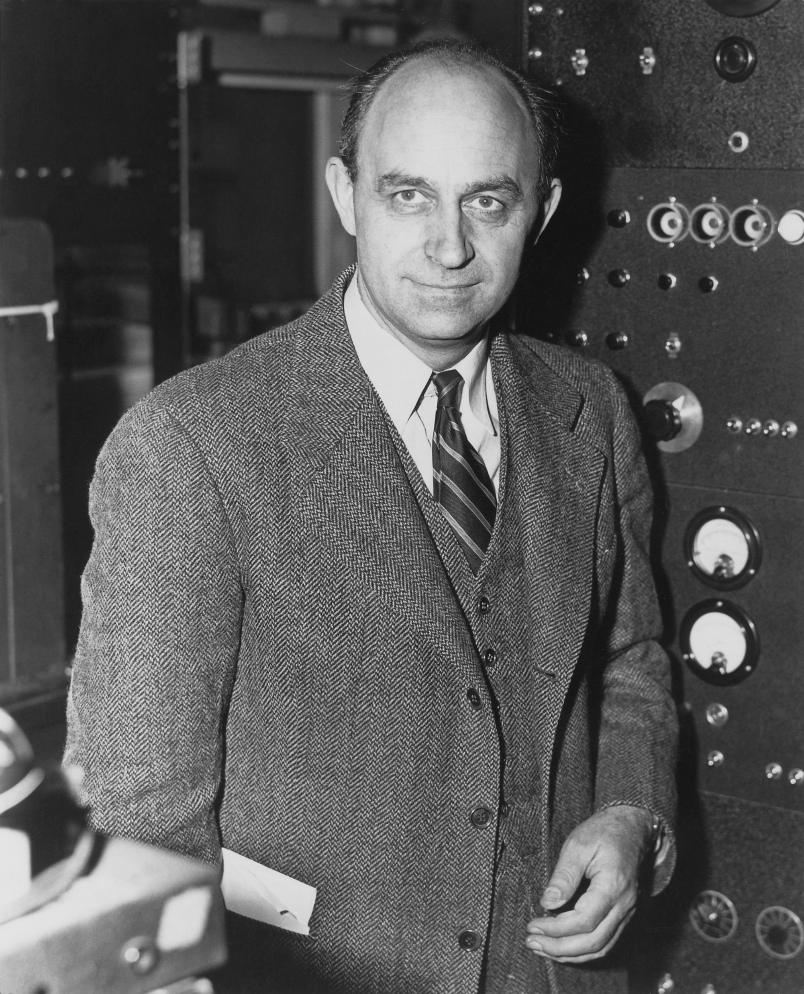
Molecular dynamics
Enrico Fermi
(DOE)

Slide 17
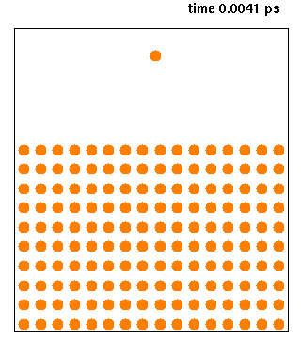
Molecular dynamics
Simulate the behavior of particles by implementing physical laws
Simulate how particles move according to the forces between them
Increasingly used in biology
Protein shapes and interactions
Knordlun on Wikipedia
Molecular dynamics

Slide 18
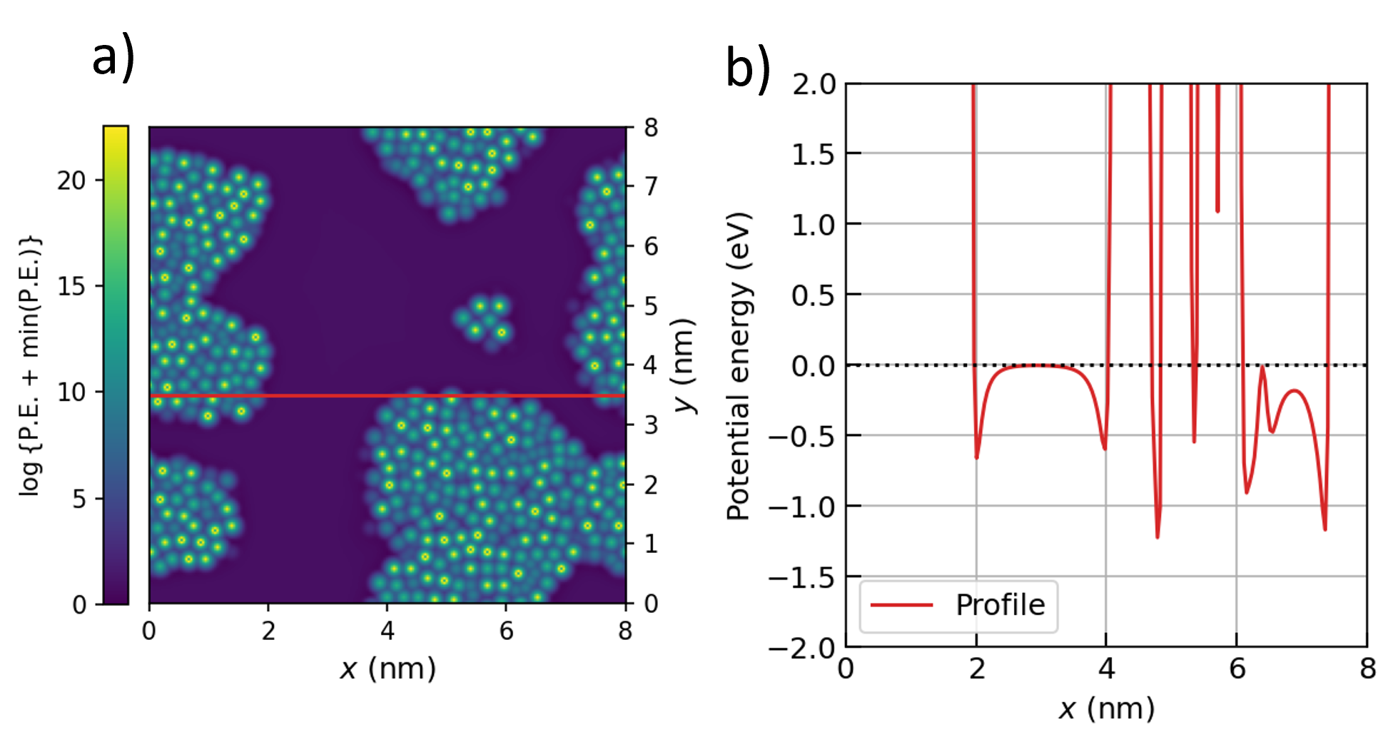
Using potentials
Create ‘force fields’ to model the forces between molecules
Apply them by Newtonian mechanics
Can use quantum mechanics
Many possible potentials, including from theory or from experiment
Choice depends on application
Molecular dynamics

Slide 19
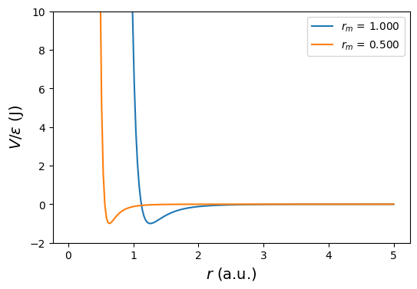
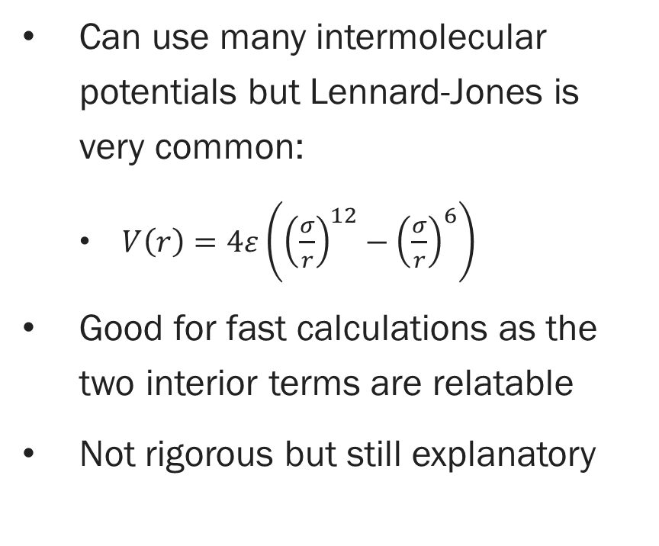
Potentials and forces
Can use many intermolecular potentials but Lennard-Jones is very common:
$V\left(r\right)=4ε\left({\left(\frac{σ}{r}\right)}^{12}−{\left(\frac{σ}{r}\right)}^{6}\right)$
Good for fast calculations as the two interior terms are relatable
Not rigorous but still explanatory
Molecular dynamics

Slide 20
Pros and cons
Bad computational scaling with increasing particles
Multi-body effects
Dependence on time step
Very short time scales
Answer: increase your computational resources or simplify the processes (or both)
More computational power:
Expensive
Power scales slower than the problem
Simplification:
Less realistic
Less intuitive
Molecular dynamics

Slide 21
Let’s try abstracting the process
Molecular dynamics

Slide 22
Ballistic deposition

Slide 23
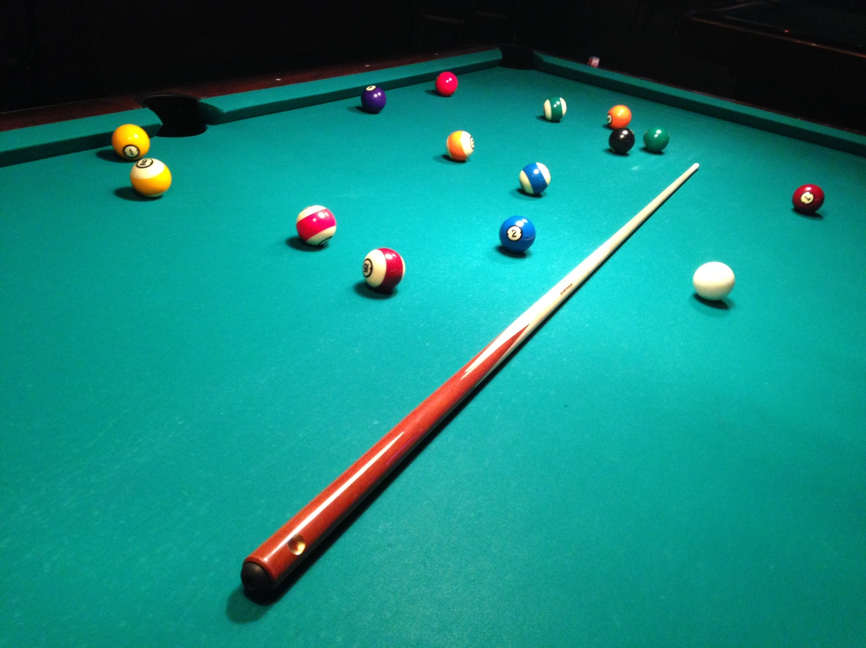
Ballistic deposition
Model individual particles as objects that collide with a surface
Developed to simulate sedimentation and aggregation in solution in 1950s/1960s
Later applied to vapor deposition simulations
Often described by KPZ equation
Hard objects physically collide with each other and their confines
Ballistic deposition

Slide 24
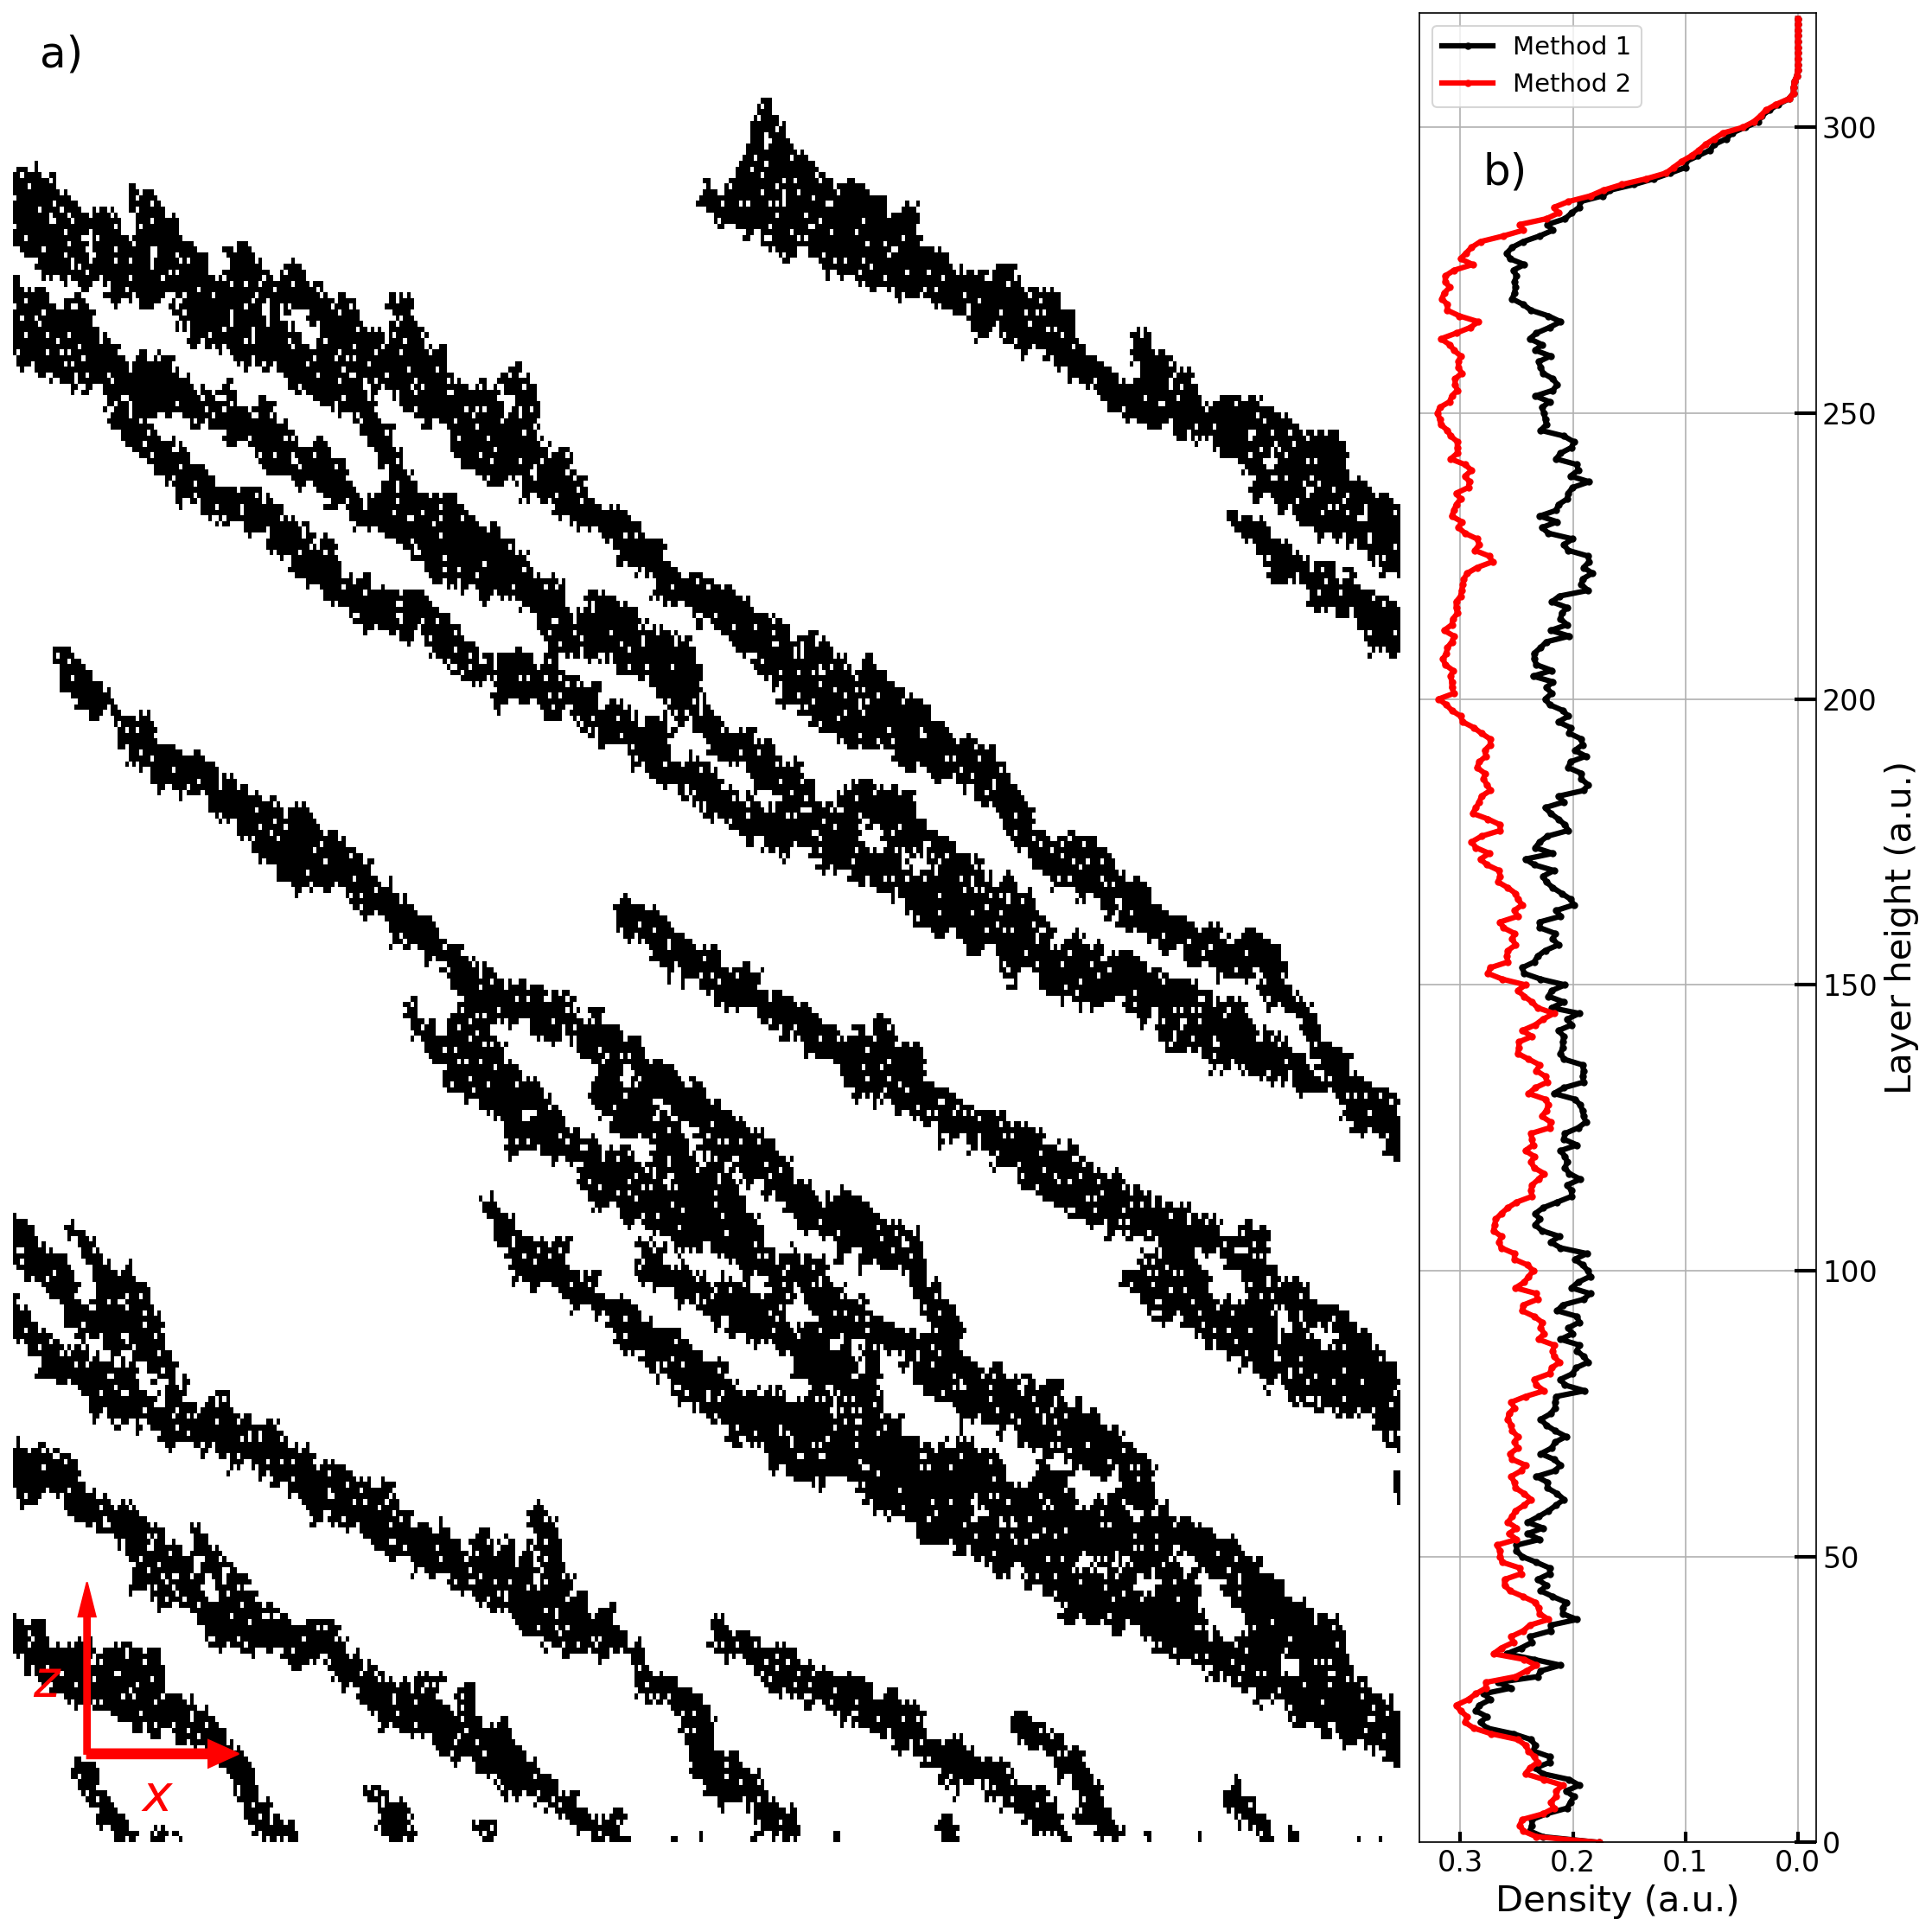
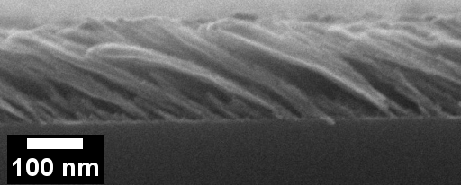
Film features
Very porous and low-density
Rough with high surface area
Substrate tilt leads to individual structures similar to each other and self-similar (‘fractal-like’)
Ballistic deposition

Slide 25
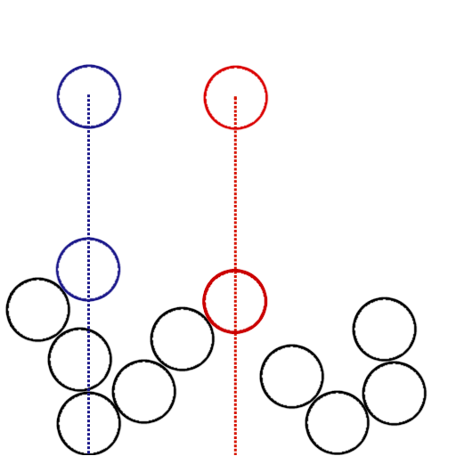
Simple ballistic deposition model
Create a 2D simulation area with a substrate along the bottom
Drop spheres one-by-one at random positions high above the substrate
Stick them where they land
Optionally, let each settle/relax/diffuse after it lands
Ballistic deposition

Slide 26
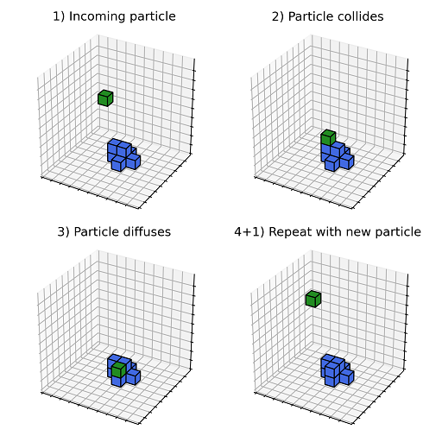
On-lattice/off-lattice or discrete-/continuous-space
Simulations can take place in discrete- or continuous-space
On-lattice and off-lattice, respectively
Discrete-space easier and faster but requires some assumptions
Imposition of lattice
Shape of particle
Most use discrete-space but early work was all continuous space
Ballistic deposition

Slide 27
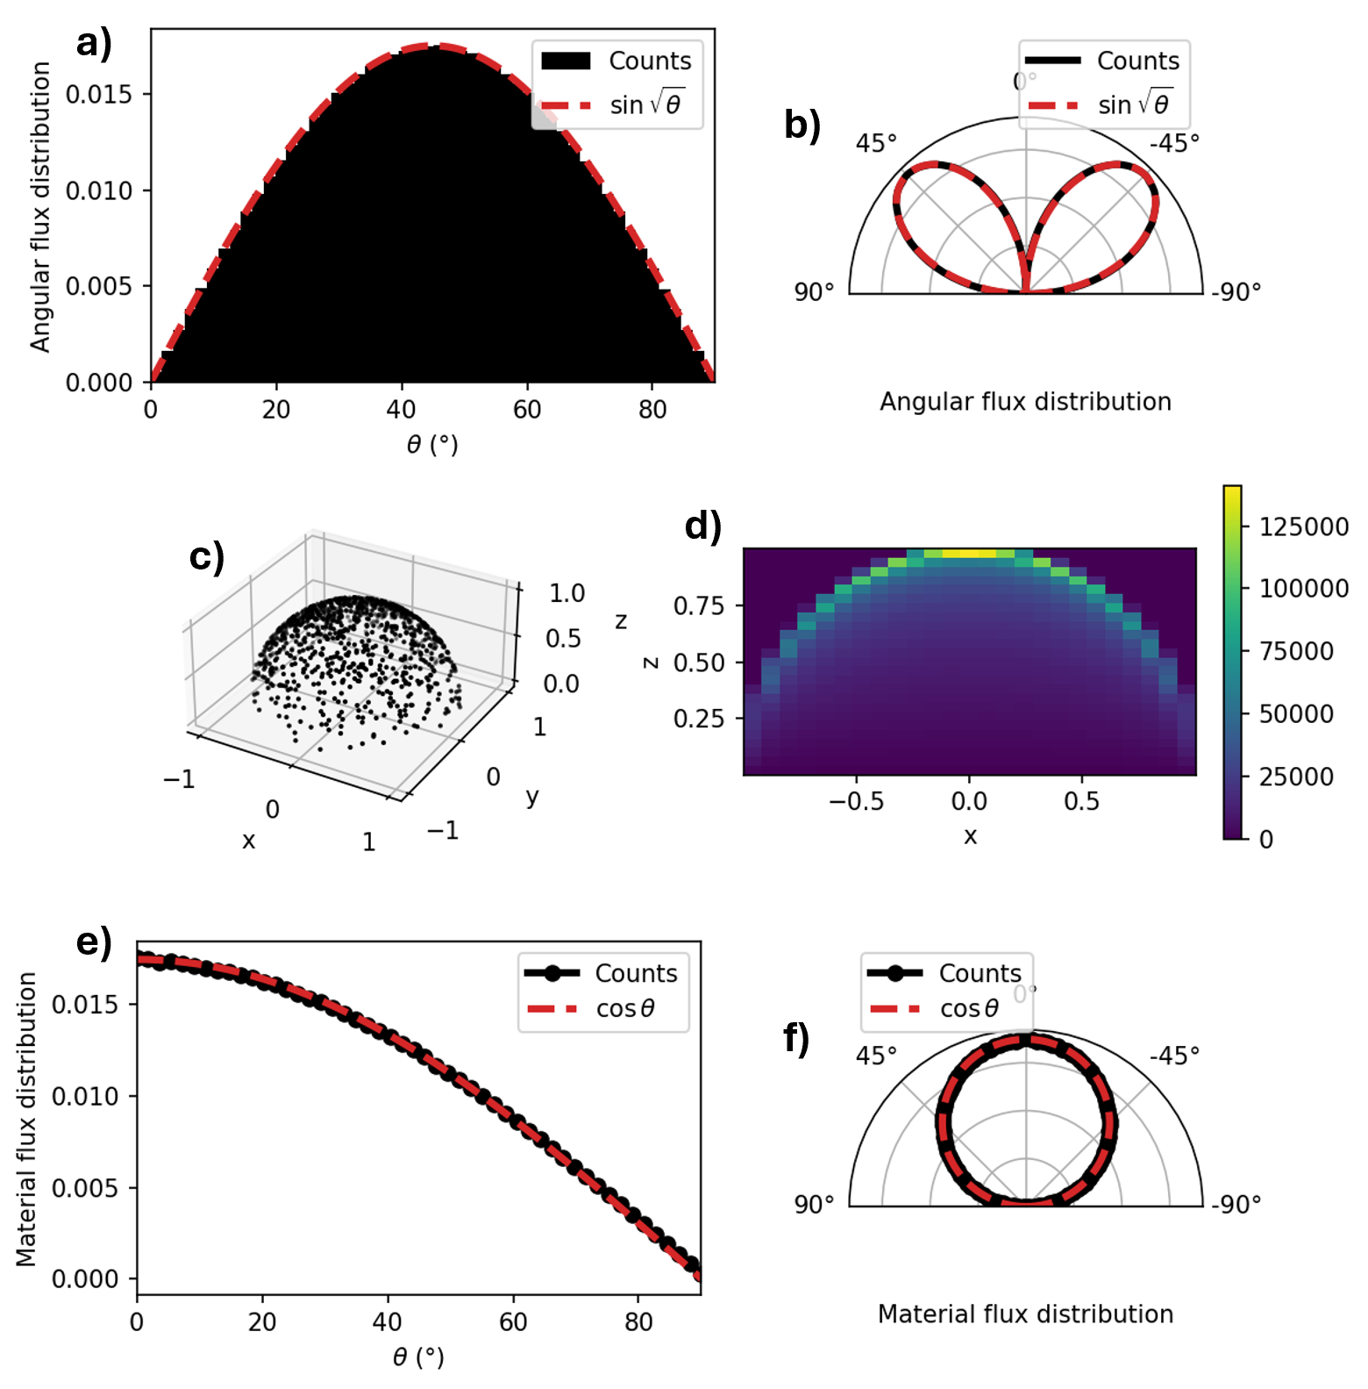
Incorporating randomness
(Probably) universally assume uniform distribution of incoming particle position
Particles can be modeled with an angular distribution
Be careful to use it correctly
Diffusion can be randomized
Use Monte Carlo method to simulate process
Ballistic deposition

Slide 28
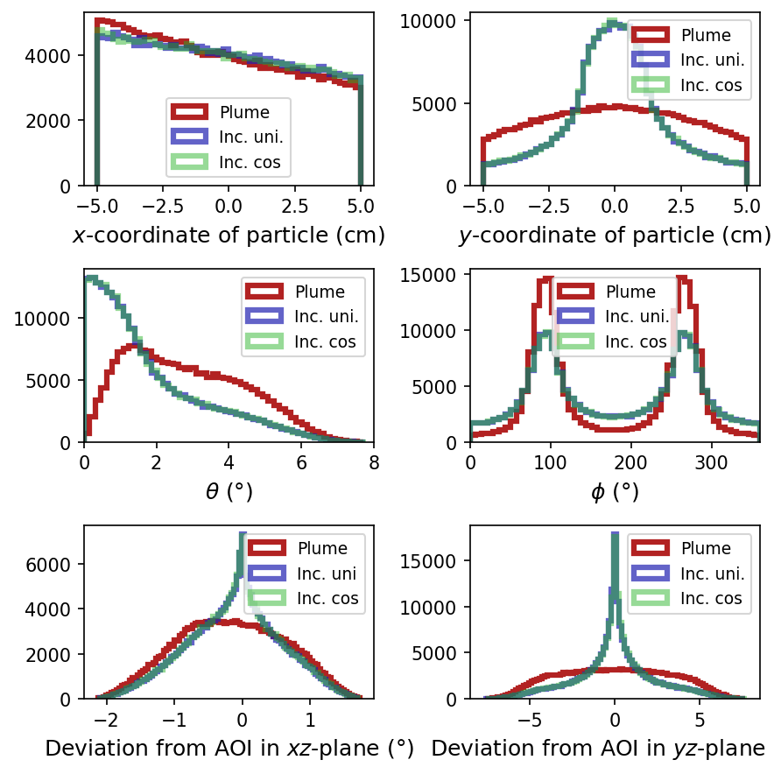
Monte Carlo method basics
Use repeated random sampling to collect aggregate results
Useful for determining numerically what is difficult analytically
Large numbers of sampling are generally better, so computers are useful
Monte Carlo method

Slide 29
Conclusion
Growth equations
Molecular dynamics
Growth equations
Good:
Well-studied equations
Bad:
No overhangs
No exact solution
Time-step dependence
Good:
Directly apply physics
Tailorable to needs
Many mature methods
Bad:
Slow; scales poorly
Time-step dependence
Good:
Fast
Easily created
Simple
Bad:
Same problems as MD or discretized
Time is arbitrary
Conclusion

Slide 30
Bibliography
Andersson, “The Initial Growth of Vapour Deposited Gold Films”, Gold. Bull. 15 (1982)
Colin et al., “In Situ and Real-Time Nanoscale Monitoring of Ultra-Thin Metal Film Growth Using Optical and Electrical Diagnostic Tools”, Nanomaterials (2020)
Marjorie Vold, “Computer simulation of floc formation in a colloidal suspension”, Journal of Colloid Science 18, 684-695 (1963)
Barabasi and Stanley, “Fractal Concepts In Surface Growth”, Cambridge University Press (1995)
Bibliography

Slide 31
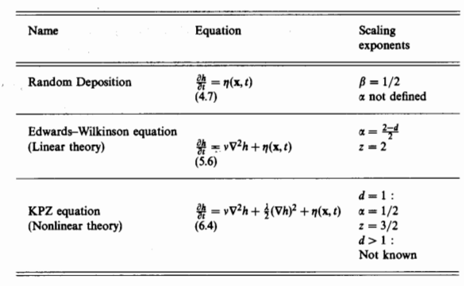
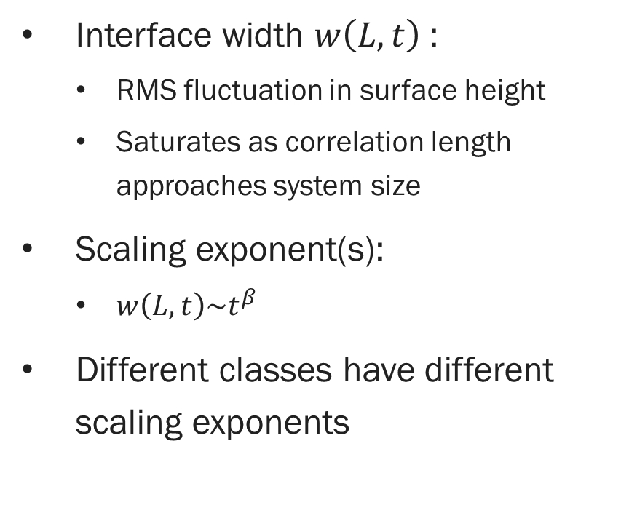
Scaling exponent
Interface width $w\left(L,t\right)$:
RMS fluctuation in surface height
Saturates as correlation length approaches system size
Scaling exponent(s):
$w\left(L,t\right)\sim t^{β}$
Different classes have different scaling exponents
Barabasi and Stanley, 1995 [4]
Growth equations

Slide 32
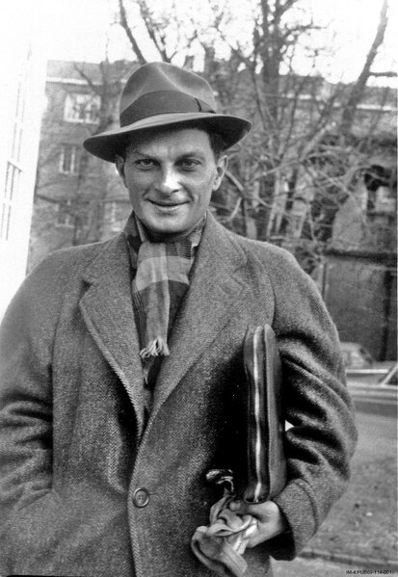
Monte Carlo method
Stansilaw Ulam (Los Alamos National Laboratory)

Slide 33
Monte Carlo method basics
Use repeated random sampling to collect aggregate results
Useful for determining numerically what is difficult analytically
Large numbers of sampling are generally better, so computers are useful
Procedure:
Determine the range of potential inputs
Draw samples from the range of inputs
Process the samples according to the model being analyzed
Record the individual and/or aggregate results
Monte Carlo method

Slide 34
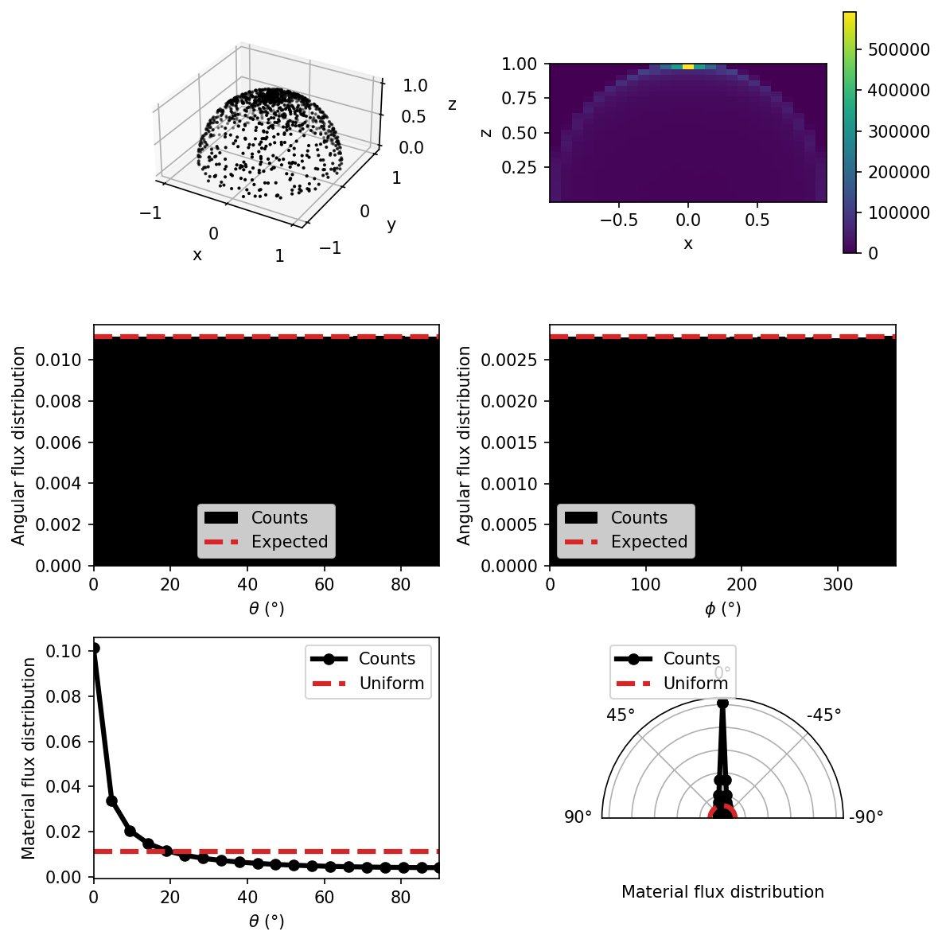
Monte Carlo considerations
Correctly sample the correct distribution!
Some advanced techniques exist to sample more complicated distributions
Increasingly used wherever statistics are useful
Particle physics, finance, operations, etc.
Monte Carlo method

Slide 35
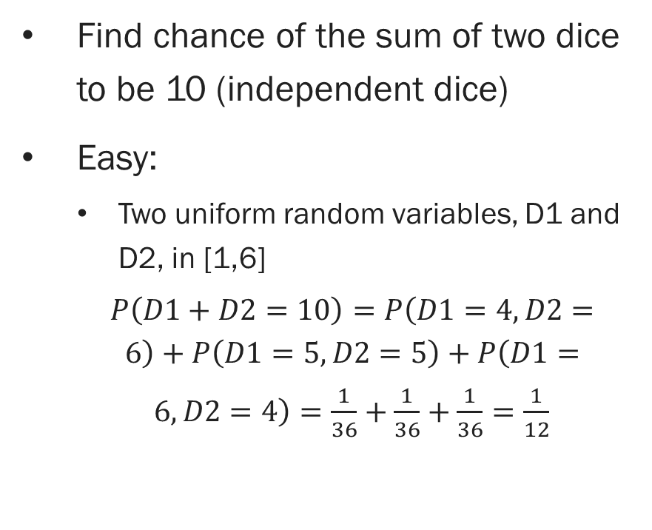
Counter example: Sum of dice
Find chance of the sum of two dice to be 10 (independent dice)
Easy:
Two uniform random variables, D1 and D2, in [1,6]
$P\left(D1+D2=10\right)=P\left(D1=4,D2=6\right)+P\left(D1=5,D2=5\right)+P\left(D1=6,D2=4\right)=\frac{1}{36}+\frac{1}{36}+\frac{1}{36}=\frac{1}{12}$
Easily extended to find the chance of any possible sum
Just count the individual probabilities and sum them
Monte Carlo method not necessary here
Monte Carlo method

Slide 36
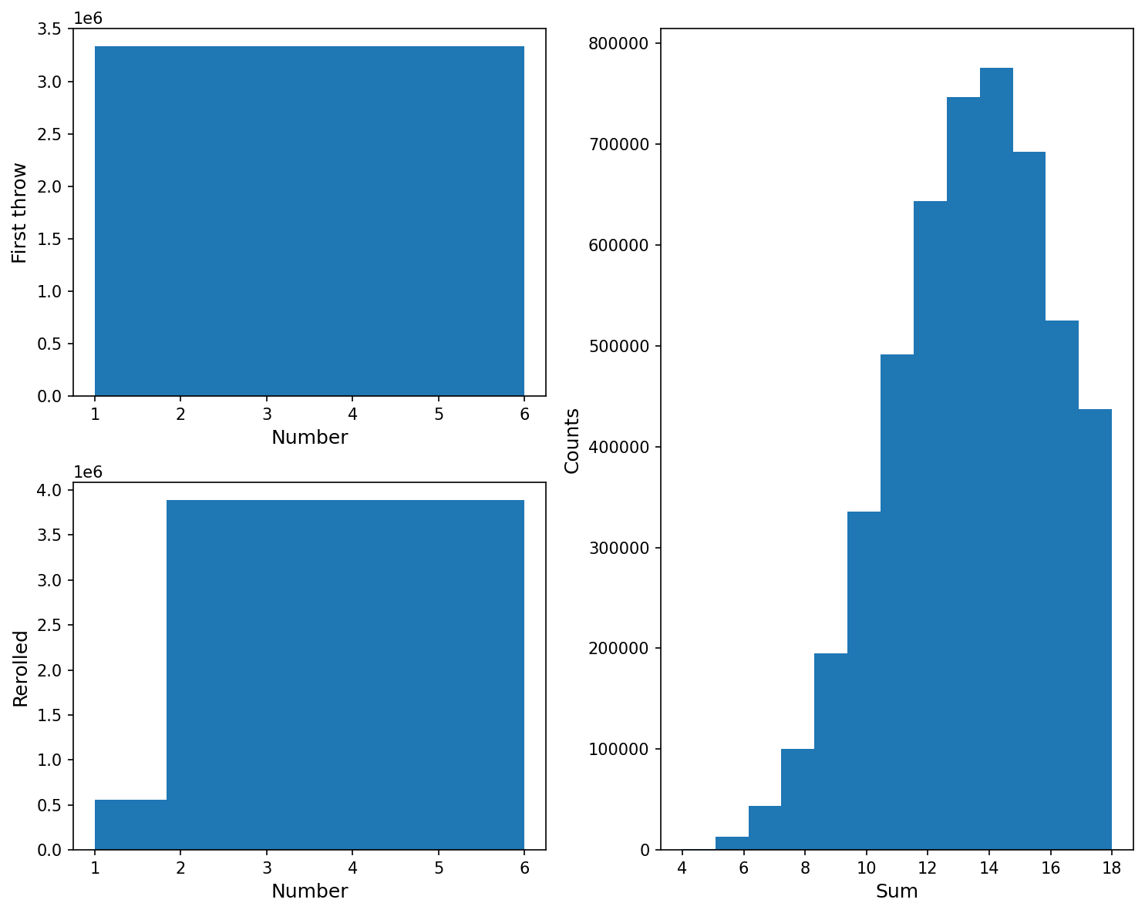
Example: Complicated sum of dice
Roll four dice, reroll any 1s on the first throw, then sum the three largest:
[4, 4, 1, 1] -> [4, 4, 2, 1] -> 10
Much more complicated to figure out analytically
Monte Carlo method

Slide 37
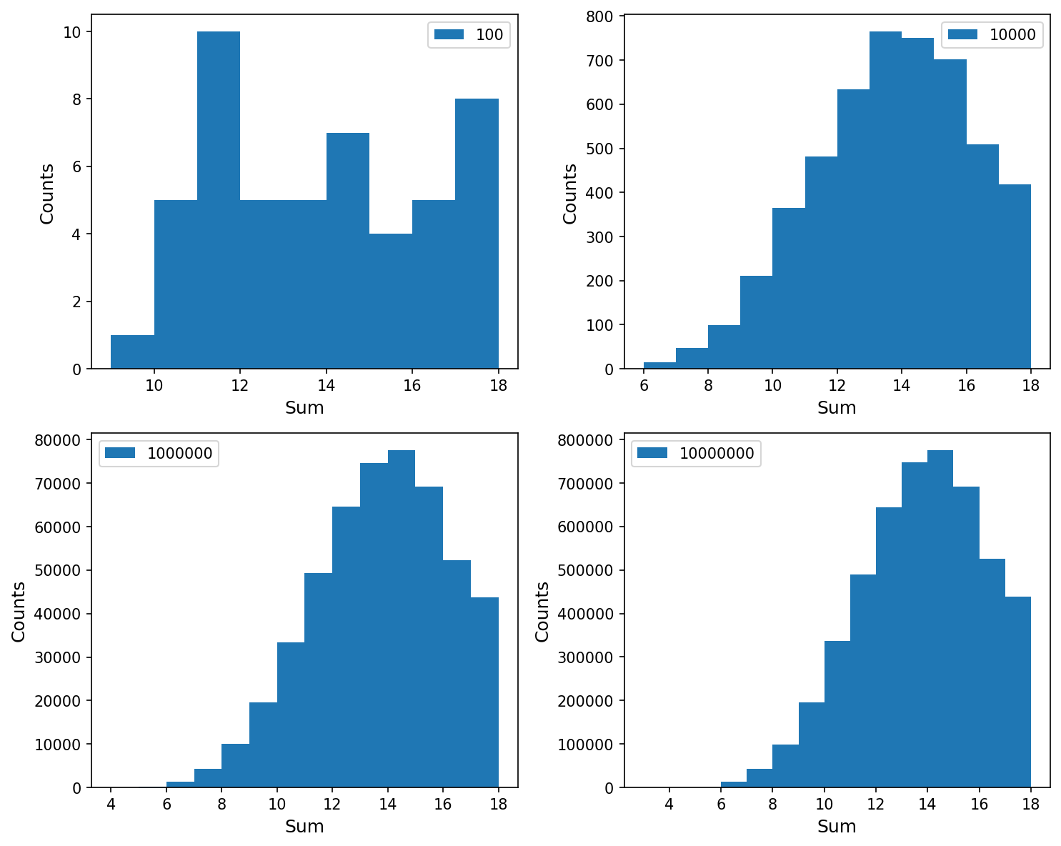
Example: Complicated sum of dice
The quality of the results depends on the number of samples
More complicated processes might require many more samples, particularly to find the ends of the range
Monte Carlo method

Slide 38
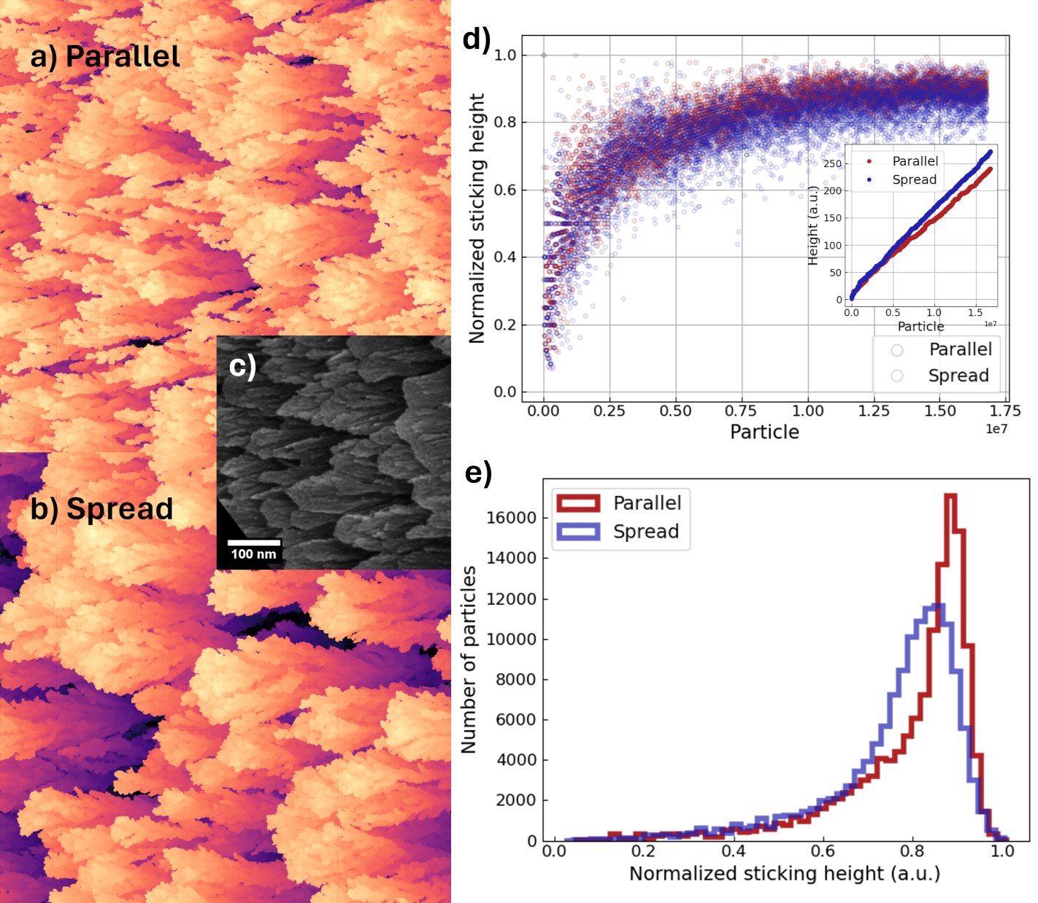
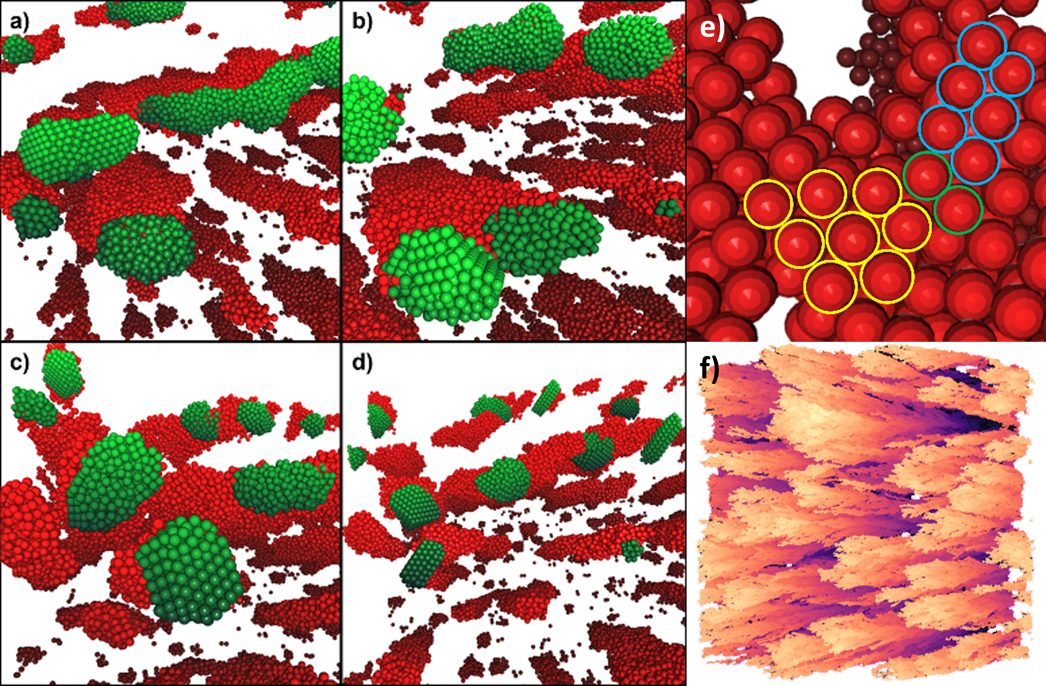
Examples

